Slide 1
Poe Part 1 Presentation

Slide 2
AGENDA
Introduction (Purpose of the Cyber Security Chat Bot)
Features
Chat Bot Logic
User interaction
Challenges and Solutions
Conclusion

Slide 3
Introduction Purpose
Teaches users about cybersecurity interactively.
How it Helps
Answers questions on topics like phishing, malware, and passwords.
Features
Greets users.
Explains cybersecurity topics.
Displays a logo in ASCII.
Plays a welcome sound.

Slide 4
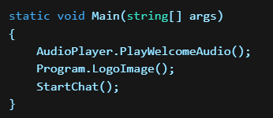
This initializes the chatbot by playing a welcome message, displaying the ASCII logo, and starting the chat interaction.

Slide 5
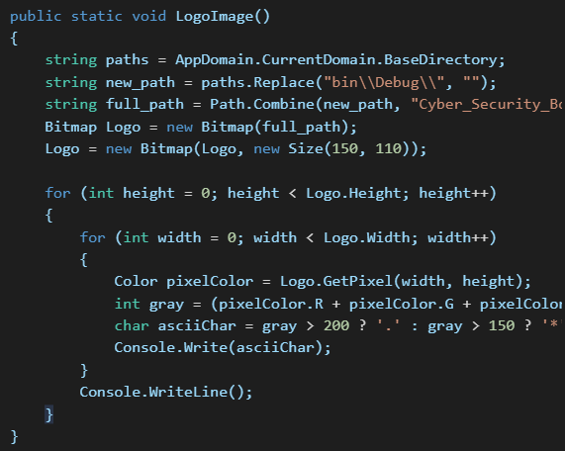
Ascii image
Techniques for connecting
This method converts an image into an ASCII representation and displays it in the console.
The image file path is dynamically retrieved to ensure compatibility.
Bitmap resizing ensures that the image fits the console output.
Grayscale conversion helps determine ASCII characters for better visual representation

Slide 6
User interaction Greeting the User
The chatbot asks for the user’s name and gives a warm welcome. Taking User Input
The chatbot waits for the user to type a question.
It removes case sensitivity to accept various inputs. Handling Exit Commands
Users can type "exit," "bye," "goodbye," or "later" to close the chatbot.
The chatbot responds with a farewell message before exiting.

Slide 7
Challenges & Solutions
Challenges
Solutions
Implementing ASCII image display in the console
Handling user input variations
Used pixel grayscale conversion to generate ASCII characters
Converted input to lowercase and trimmed whitespace for better matching

Slide 8
Summary & Future improvements
Summary
Possible Improvements
Provides information on passwords, phishing, malware, and online safety.
Users can ask questions and get instant responses.
Uses colors for clarity and simple text-based interaction.
Allows users to exit by typing "exit," "bye," or similar words
Plays a welcome audio and displays a cybersecurity logo.
Graphical User Interface (GUI) – Upgrade from a console app to a GUI-based chatbot for better visuals.
Smarter AI Responses – Integrate machine learning or a chatbot API for more dynamic and personalized answers.
More Topics & Database Support – Expand knowledge beyond cybersecurity and connect to an online database for updated information.

Slide 9
THANK YOU
ODIRILE MASEMOLA
069 232 8588
ST10441421
odirilemasemola1@gmail.com

